Slide 1

Federica Annecchini, Ana Laura Barrales Walt, Nicola Calzà, Giacomo Inzani, Nikhil Kotha
Image Analysis Group

Slide 2

The challenge
Dr. Anna Alisi,
Chief of Liver Research Unit

Slide 3
The pathology: NAFLD
  Progressive fat accumulation in liver's cells:
    Hepatocytes
    Hepatic Stellate Cells
  Degenerate into Fibrosis and Cirrhosis
  Increasing incidence

Slide 4
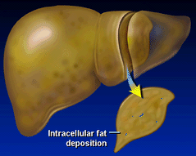
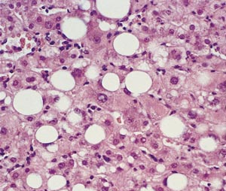
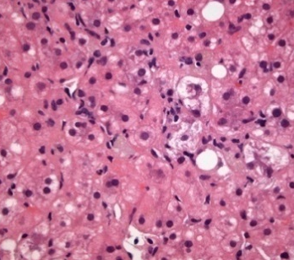
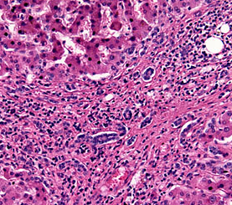
NAFLD progression
Simple Steatosis
Steatohepatitis (NASH)
Cirrhosis

Slide 5
NAFLD incidence
DA STUDIARE

Slide 6
NAFLD incidence

Slide 7
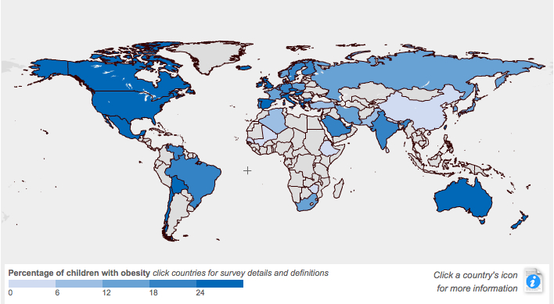
NAFLD and obesity
Courtesy of Prof. A. Vania, ECOG’s President

Slide 8
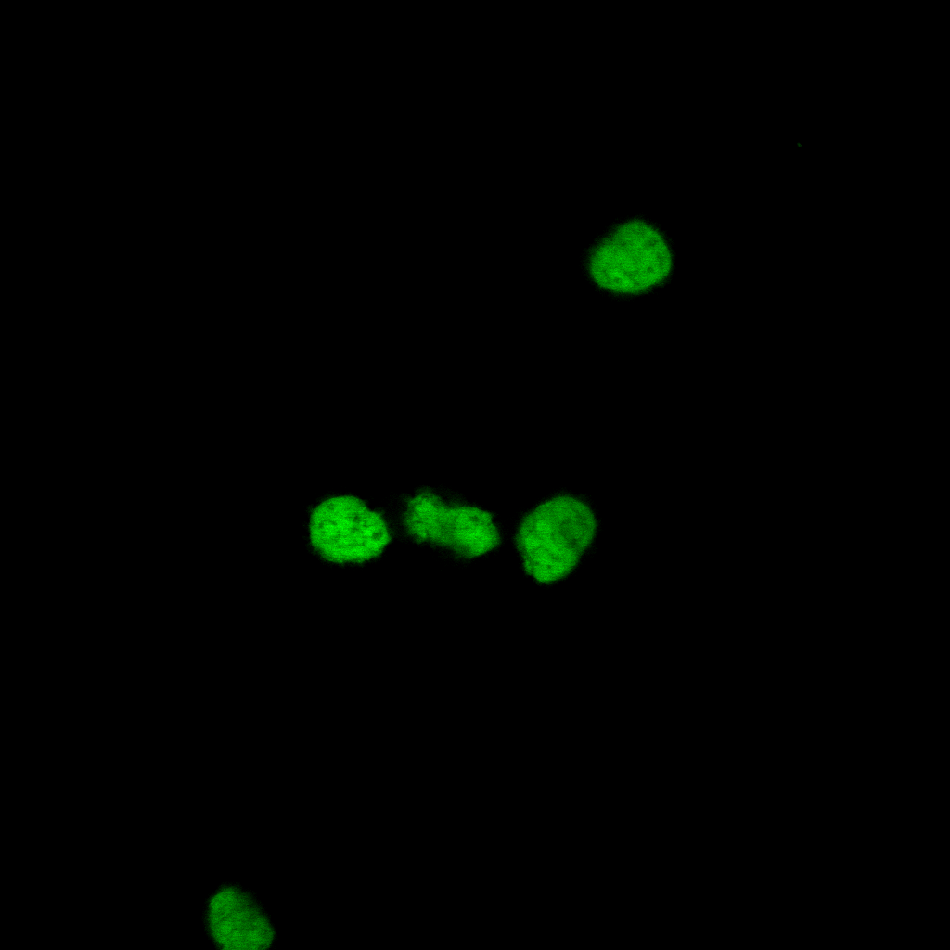
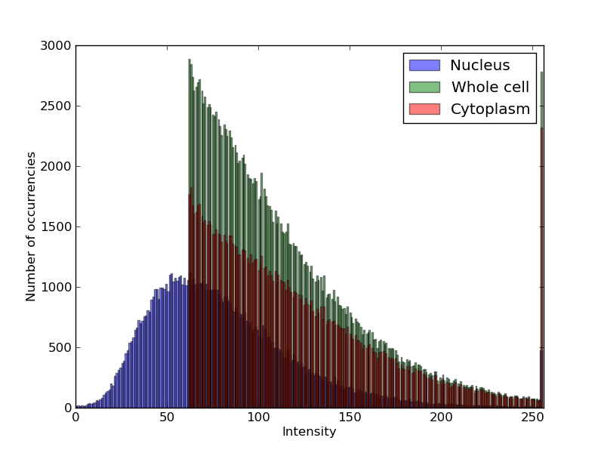
TASK
* Measure LITAF in cellular nucleous in defferents conditions.
* Stellate A primary cell mide in vitro.
PROCESS
INPUT IMAGES.
NUCLEI IDENTIFY
LITAF INTENSITY EXTRACTION
INTENSITY DISTRIBUTION

Slide 9
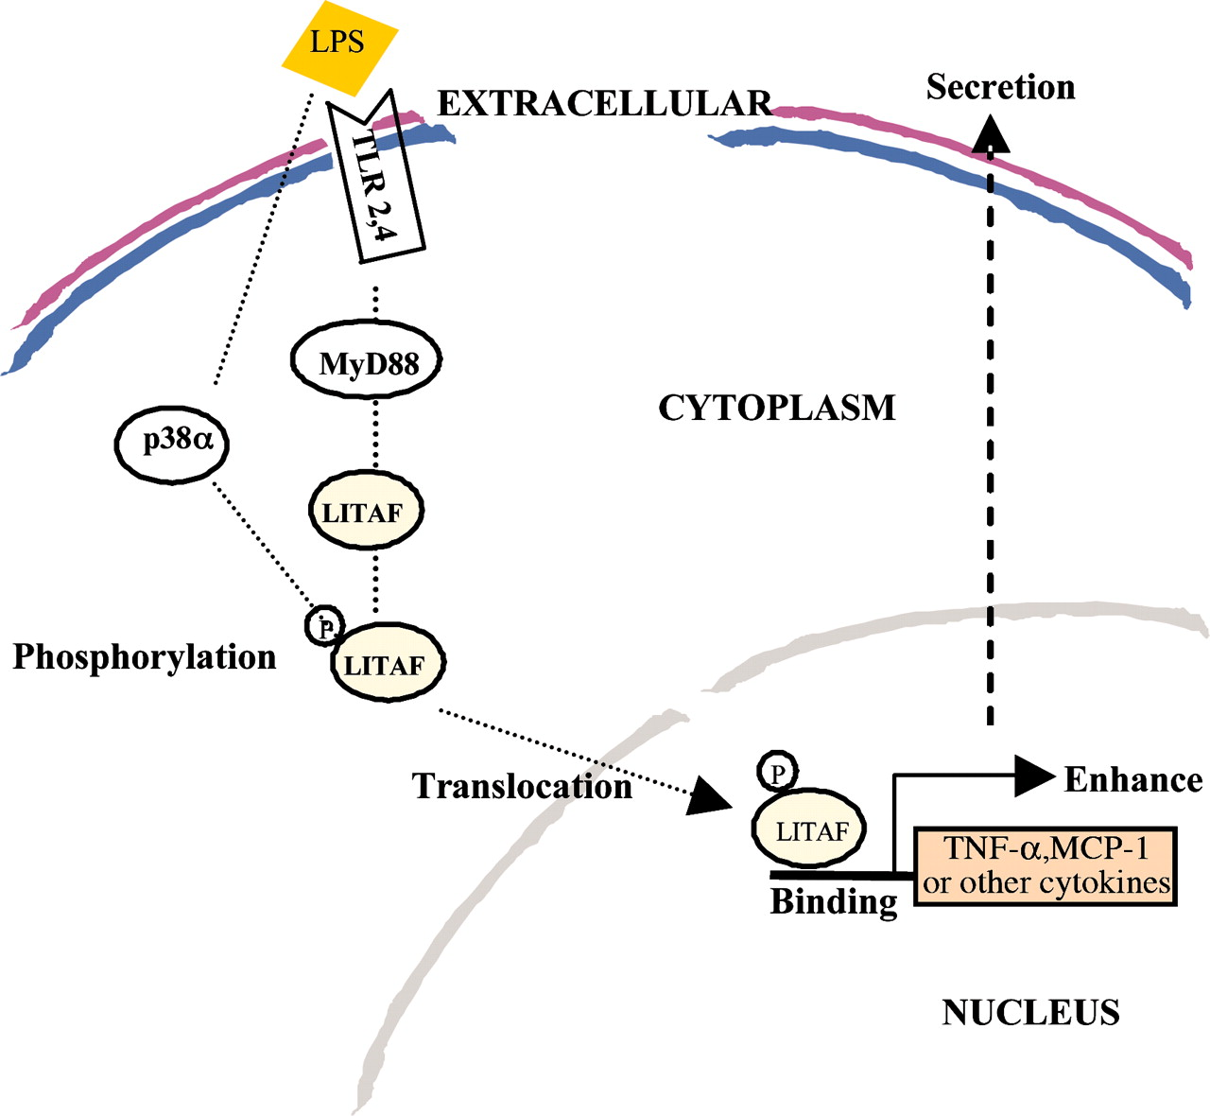
From LPS to NAFLD through LITAF
LPS = Lipopolysaccharide, found in outer membrane of bacteria
LPS has already been associated to tumors
LPS induce the P38 to phosphorylate the LITAF
LITAF = LPS-induced TNF-alpha factor, trascription factor
LITAF traslocate to the nucleus activating the production of several cytokines
Cytokines causes an inflammatory response and expression of alpha-SMA in the liver, deforming the cells and causing NAFLD

Slide 10
NAFLD incidence

Slide 12
NAFLD
Increasing incidence
Progression of fat accumulation in the liver
Hepatocites
Stellate
Going to fibrosis and cirrhosis

Slide 13
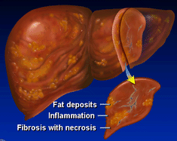
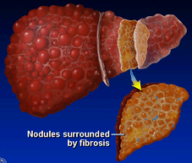
Steatohepatitis (NASH)
Simple Steatosis
Cirrhosis

Slide 14
Non-alcoholic fatty liver disease (NAFLD) is a major health prob-
lem that integrates several liver conditions ranging from simple
fatty liver to non-alcoholic steatohepatitis (NASH), which is
sometimes associated with fibrosis that may evolve into cirrhosis
and result into hepatocellular carcinoma.
The effects of specific
risk factors, such as obesity and sedentary lifestyle, on predispos-
ing genetic settings eventually lead to the development of NAFLD
in children.

Slide 15
Incidence
Incidence of LITAF on Italian children
Epidemiology
In an Italian study, 72 obese children presented with
ultrasonographic fatty liver (50% of cases) and/or hypertransam-
inasemia (25% of cases)
Population-based studies conducted with ALT or ultrasonog-
raphy in several countries have shown that paediatric NAFLD
prevalence remains in a range of 2.6–7.1% of children. An
autoptic study in California, conducted in children deceased for
accidents, showed a prevalence of histological NAFLD ranging
from 0.7% in 2–4 year old to 17.3% in 15–19 year old subjects. In cohorts of children of various nationalities selected for
overweight or obesity, the prevalence of elevated ALT is higher
and ranges from 8 to 42%, whereas the prevalence of bright liver ranges from 1.7 to 77% . In an autoptic study by Schwimmer
et al., prevalence of histological NAFLD in obese individuals was
38%
https://dub116.mail.live.com/default.aspx?id=64855#!/mail/ViewOfficePreview.aspx?messageid=05d34622-ef21-11e2-b8a6-00237de4b224&folderid=00000000-0000-0000-0000-000000000001&attindex=0&cp=-1&attdepth=0&n=1368386816

Slide 16
Incidence of obesity
As the prevalence of obesity in children increases, so does the prevalence of paediatric NAFLD.
The latest surveys estimate the prevalence of pediatric
NAFLD as close to 70–80% in obese indivi­
duals, with a male-to-female ratio of 2:1.
https://dub116.mail.live.com/default.aspx?id=64855#!/mail/ViewOfficePreview.aspx?messageid=05d34622-ef21-11e2-b8a6-00237de4b224&folderid=00000000-0000-0000-0000-000000000001&attindex=1&cp=-1&attdepth=1&n=582272294

Slide 17
Courtesy by Prof Vania ECOG’s President

Slide 18
In particular OPBG studies the insurgence of pediatric NAFLD, searching for molecular mechanisms: one promising approach in Anna's lab is studyng LPS

Slide 19
LPS
LPS is the major component of the outer membrane of Gram-negative bacteria. LPS is an endotoxin, and induces a strong response from normal animal immune systems.

Slide 20
From LPS to LITAF

Slide 21
They study LITAF
LITAF is an LPS -induced protein which should be located in the spleen but was found expressed in NAFLD affected liver cell
Hepatocytes
Stellate

Slide 22
LITAF is expressed in NAFLD
Red= LITAF

Slide 23
P38
LITAF traslocation
LITAF in the nucleo
TNF-a
Cytokines
Fibrosis
Inflammation

